Slide 1


Retail Sales Data – Price Trends
Group Project Presentation by Pranay & Niharika

Slide 2

Project Objective
Data Cleaning & Analysis
Using Python and SQL for accuracy
Trend Extraction
Identify sales and customer patterns
Visualizations
Pandas, Seaborn, Matplotlib tools
Business Insights
Actionable recommendations from data

Slide 3

Dataset Overview
Source & Size
Kaggle Online Retail Dataset
1,000 transactions
Fields Included
Transaction ID
Country Age
Product Category

Slide 4
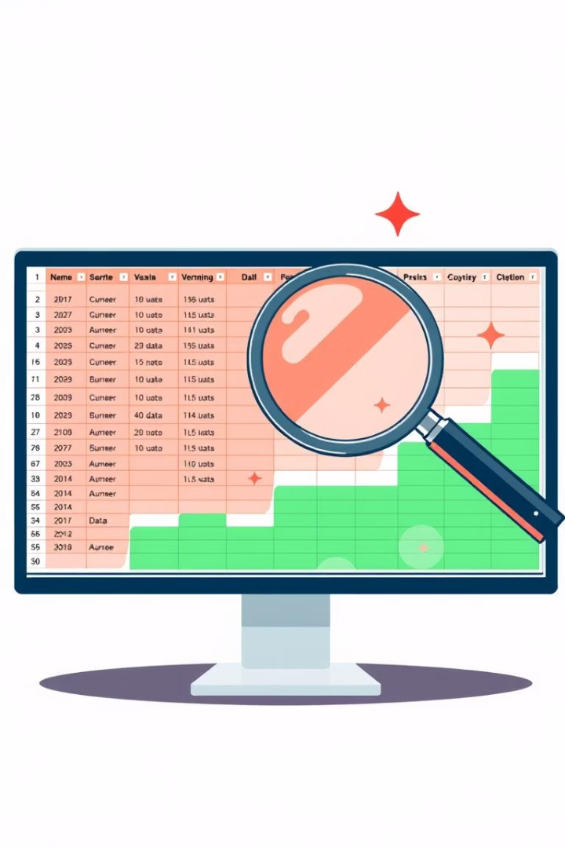
Data Cleaning Process
Standardizing Date Formats
Changed date field from object to datetime data type
Filter Orders
Exclude cancellations
New Metric
TotalPrice calculated: Quantity × UnitPrice

Slide 5
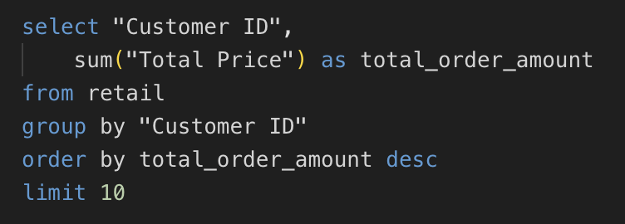
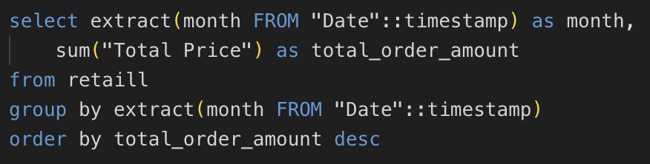
SQL Insights
Top Customers
Ranked by total spending
Sales by Country
Aggregated revenue data
Peak Sales Months
July & September identified
Order Value
Average spending per customer

Slide 6
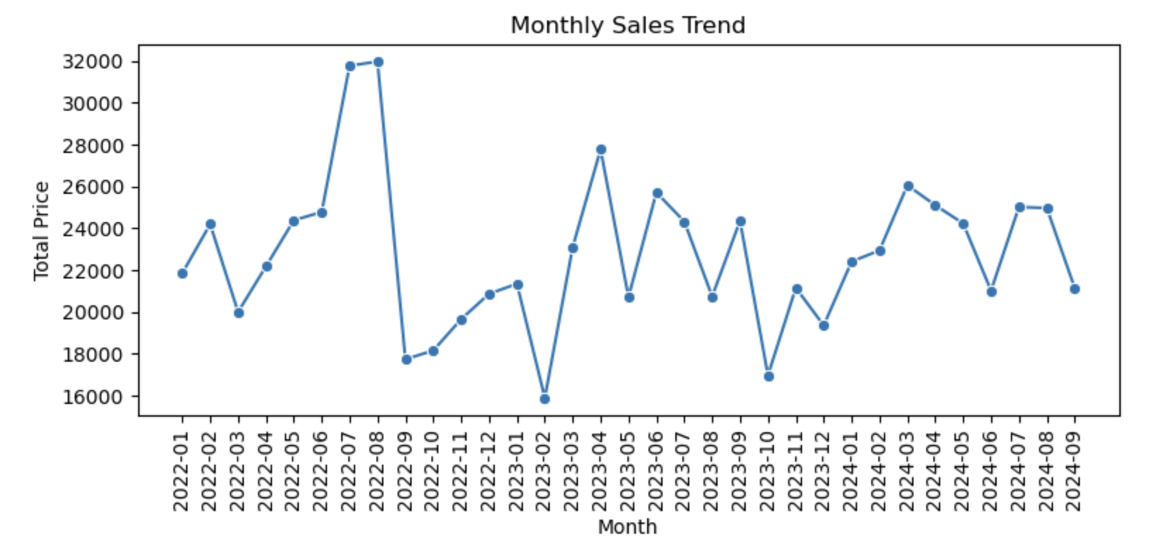
Exploratory Data Analysis & Visualizations
Monthly Sales Trend
Line plot shows growth
Top Countries Revenue
Bar chart comparison
Top 5 Customers
Pie chart market share
Sales Heatmap
Month-country performance visualization

Slide 7
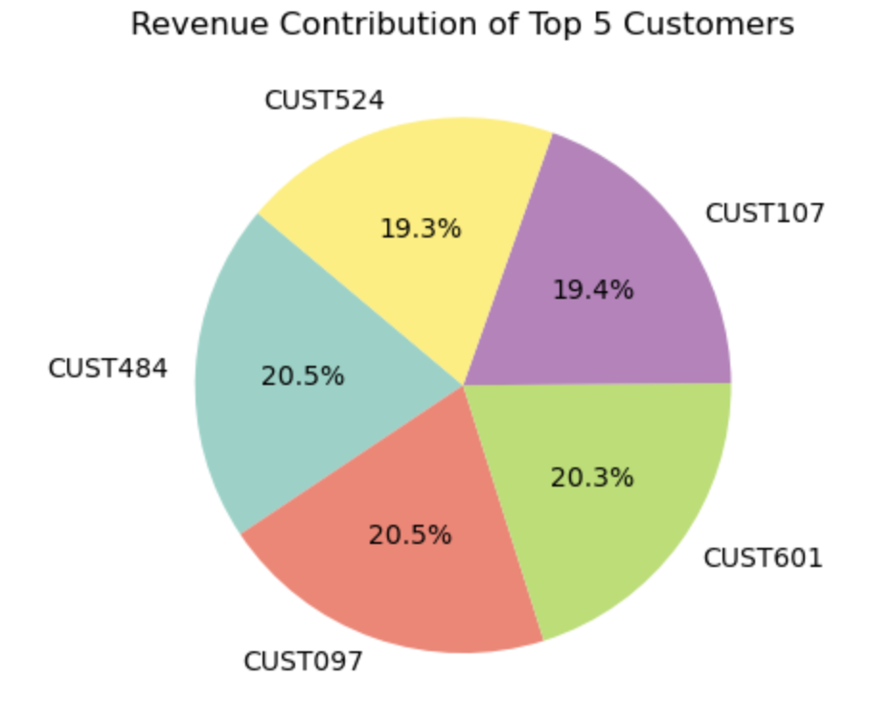
Key Business Insights: Trends & Geography
Top Months
July and August highest revenue
Country Peaks
USA May & June, Germany July & Feb
Top Countries
Germany, Turkey and Indonesia lead revenue
Opportunity Markets
Japan, Malaysia, Taiwan low revenue
Product Focus
Beauty top category

Slide 8

Revenue & Heatmap Insights
Total Revenue
751,986 overall
Unique Customers
928 customers recorded
Targeted Marketing
Focus on Japan, Malaysia, Taiwan
Cross-Sell Potential
Use top customers & countries analytics

Slide 9

Team Contributions
Team Member
Responsibility
Niharika
SQL insights, Exploratory Data Analysis
Pranay
Data cleaning, preprocessing, visualizations

Slide 10


